Slide 1
CREDIT CARD FRAUD DETECTION BY USING MACHINE LEARNING
ARINDOM BHATTACHARJEE DST 004
DEEPJOY BISWAS DST 012
SUPERVISED BY DR. SANJIT MAITRA
INDIAN STATISTICAL INSTITUTE, TEZPUR
Notes:
I

Slide 2
1.INTRODUCTION 2.OBJECTIVE 3.METHODOLOGY 4.RESULTS

Slide 3
Abstract:-
Now a days Using technology like phishing technique to do internet
banking, fraud means transferring and removing the money from banker
Account without the permission of the banker. credit card frauds are
happening in large amount and also some banking companies
and the companies giving service to banks are facing problem. In this
project trying build the model which predict fraud and nonfraud transaction
in best way using machine learning algorithms

Slide 4
Objective:-
Project is to predict the fraud and fraud less transaction with respect to the amount of the transaction using machine learning algorithms and statistics INTRODUCTION:-
Credit card frauds are increasing heavily because of fraud financial loss is increasing drastically. Now a days,Internet or online transaction growing as new technology are coming day by day.In these transaction credit cards holds the maximum share.There are different types of frauds occurring as technology is growing rapidly.So, there are many machine algorithms are used to detect frauds.

Slide 5
PROBLEM STATEMENT :-
Credit card frauds are increasing heavily because of fraudfinancial loss is increasing drastically. Every year due to fraud Billions of amounts lost. To analyze the fraud there is lack ofresearch. Many machine learning algorithms are implementedto detect real world credit card fraud.
Objective of the project:-
Our project is on Credit card data set which is on detection to fraud credit card transaction. The aim is to detect or identify the fraud while using credit card transaction or not.Thus, ours is a classification problem.We have to classify the fraud while using credit card transaction or not.

Slide 6
DATA DESCRIPTION:-
We have a data set which on credit card fraud transction of customer along with some demographic information of the customer. In our dataset, there are 30000 instances and 24 attributes
Attribute Information:-
GENDER
EDUCATION
MARRIAGE
AGE
LIMIT BALANCE
PAY _0 TO PAY_6 (HISTORY OF PAST PAYMENT)
BILL_AMT1 TO BILL_AMT6 (AMOUNT OF BILL STATEMENT)
PAY_AMT 1 TO PAY_AMT 6 (AMOUNT OF PREVIOUS PAYMENT)
DEFAULT (AS A RESPONSIBLE VARIABLE)

Slide 7
1 = FRAUDULENT TRANSCATION
0 = NOT FRAUDULENT TRANSCATION
EXPLORATION OF THE DATA
After exploring the data, we have found that:
There is no missing values in our dataset
The percentage of NOT FRAUDULENT TRANSCATION
Is quite high as compared to the FRAUDULENT TRANSCATION
The percentage of non-fraud transaction = 77.88%
The percentage of fraud transaction = 22.12%

Slide 8
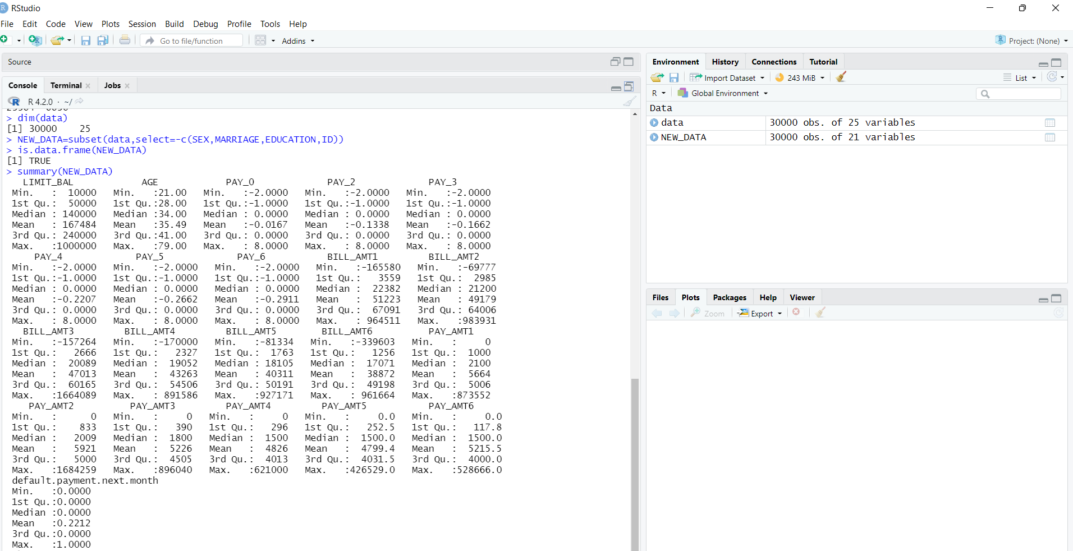
Fig :Descriptive Statistics

Slide 10
Logistic regression
Logistic regression works with sigmoid function because the sigmoid function can
be used to classify the output that is dependent feature and it uses the probability
for classification of the dependent feature.
This algorithm works well with less amount of data set because of the use of
sigmoid function if value of sigmoid functions greater than 0.5 the output will 1 if
the output the sigmoid function is less than 0.5 then the output is considered as
the 0.
Logistic regression is another powerful supervised ML algorithm used for
binary classification problems (when target is categorical). The best way to think
about logistic regression is that it is a linear regression but for classification
problems. Logistic regression essentially uses a logistic function defined below to
model a binary output variable

Slide 11
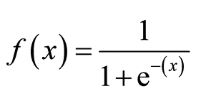
The primary difference between linear regression and logistic
regression is that logistic regression's range is bounded between 0
and 1. In addition, as opposed to linear regression, logistic
regression does not require a linear relationship between inputs
and output variables. This is due to applying a nonlinear log
transformation to the odds ratio.
Logistic Function:-

Slide 12
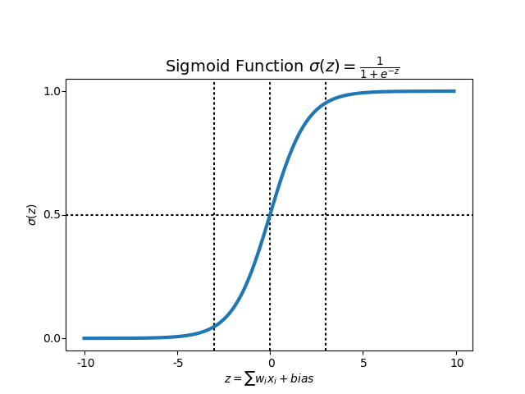

Slide 13
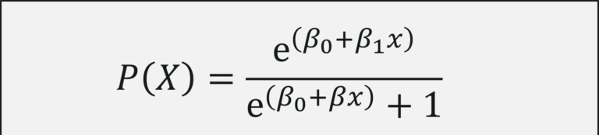
MODEL:-
Let Y be a binary responsible variable.
Yi = 1 if the transaction is fraud
= 0 if the transaction is not fraud
X = (X1,X2,……..X23) be the set of explanatory variables.Thus, the model is given by
Logit (p(x))=Log(p(x)/(1-p(x))=Bo + B1X1+B2X2+…..+B23X23

Slide 14
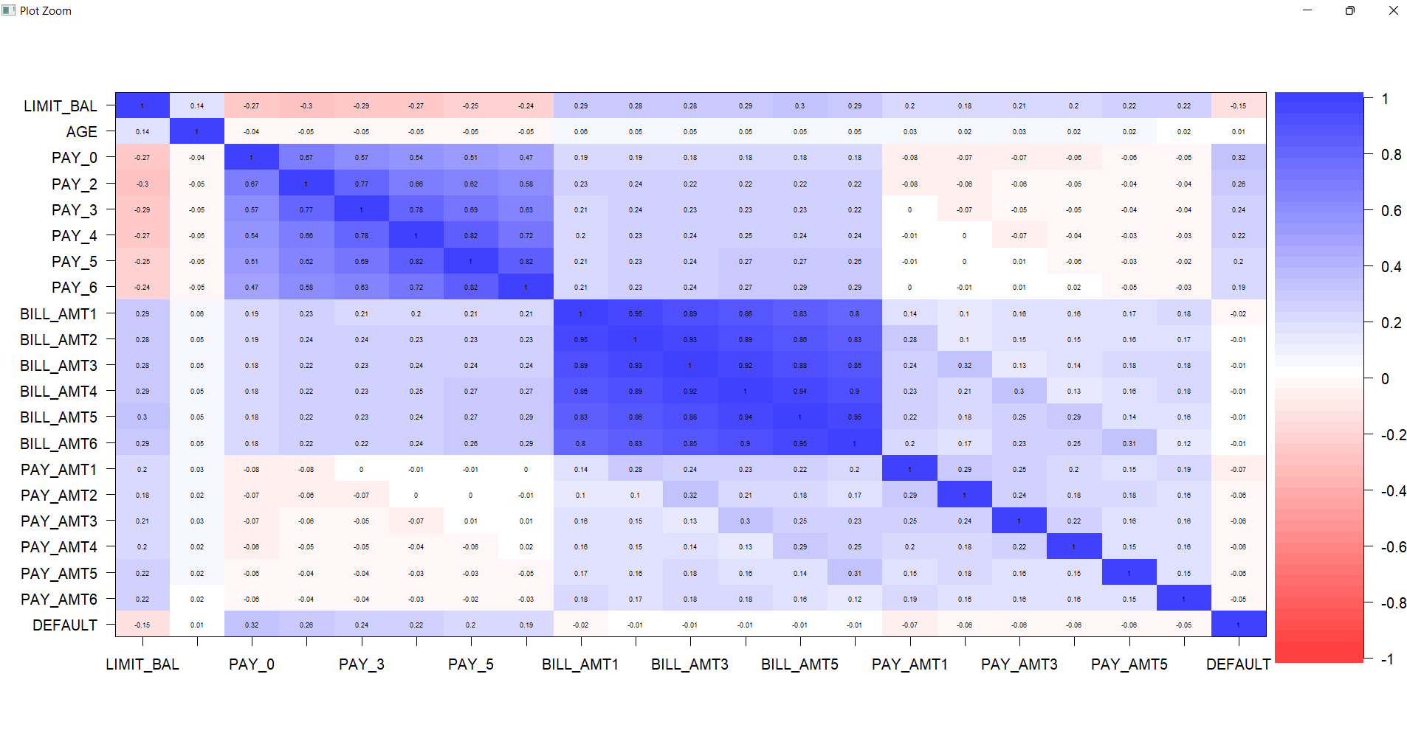
Correlation Plot:-

Slide 15
Features Engineering:-
Analysis our data above, we have been abled to noted that the extremely weak
correlation of some variables with the final target variables.The following arec the
ones which have significantly low correlation values:-AGE,BILL_AMT 1, BILL_AMT 2,
BILL_AMT 3, BILL_AMT 4, BILL_AMT 5, BILL_AMT 6,
Preprocessing:-
Standadization is the transformation that centres the data by removing the main
values of each features and then scale it by dividing(non constant) features by their
standard deviation.After the standardizing of the data the mean will be zero and stand
deviation is 1.
It is more suitable for technique that assume a Gaussian in the input variable work
better with rescaled data,such as Losictic regression and Linear
discreminantanalysis.If a features has a variance that is orederd of magnitude larger
than others it might dominat objectives function and makes the estimators unable to
learn from others features as expected .
Model development:-
We will now move to our most important step of developing our logistic model we split
our data set into 70:30 ratio and trained our model

Slide 16
Confusion Matrix:-
 | Not Fraud (0) | Fraud (1)
Not Fraud (0) | 6819 | 1568
Fraud (1) | 173 | 439

Slide 17
SENSITIVITY/Recall:= TP/(TP+FN)=0.8130
Specificity=TN/(TN+FP)=0.717
PPV=TP/(TP+FP)=0.9752
NPV=TN/(FN+TN)=0.257
Misclassification Error=1- accuracy =0.194
If we split 70:30 ratio then the accuracy of test data set is 0.806
i.e 80.60 %
If we split 80:20 ratio then the accuracy of test data set is 0.8075
i.e 80.75 %

Slide 18
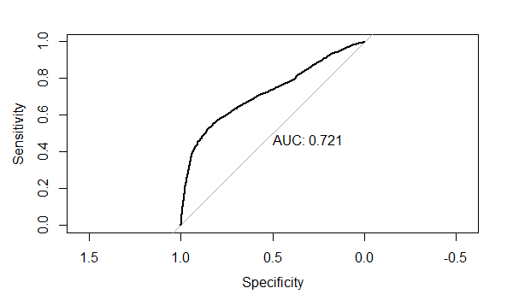

Slide 19
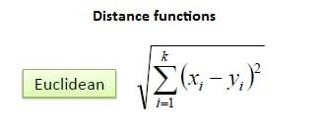
KNN algorithm (k-nearest neighbor)
One of the most efficient and simple classification algorithms, based on the majority of the neighbour’s class.
KNN workflow:
Assign k- a user defined constant for numbers of neighbour.
For each test sample, count the class of k neighbour’s class of training set.
Assigned class of each test sample by the class of majority class of each k neighbours.

Slide 20
K | ACCURACY
3 | 0.9972
5 | 0.9962
7 | 0.9955
25 | 0.9929
27 | 0.99273
19 | 0.9933
21 | 0.9934
23 | 0.9931
173 | 0.9872
179 | 0.9871
51 | 0.9915
Here the model achived 99.72% accuracy with k=3

Slide 21
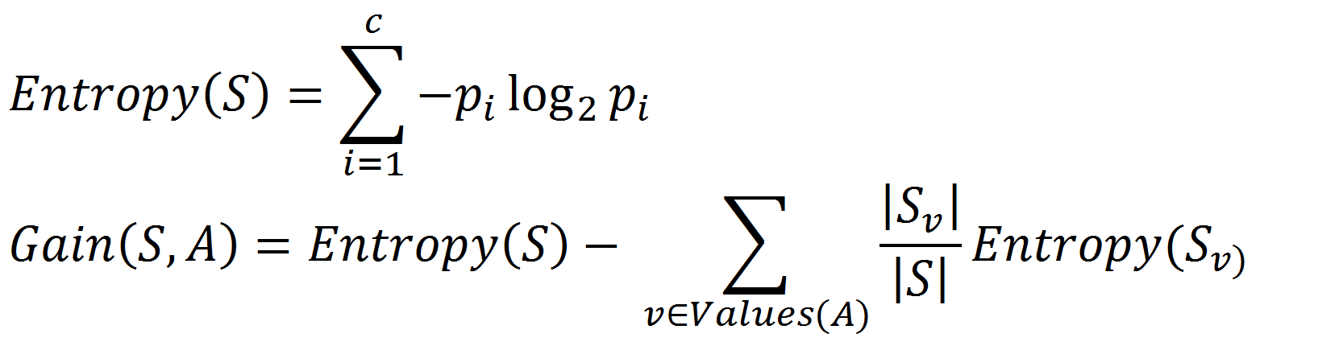
DECISION TREE:-
A decision tree is a tree shaped graphical representation used to determined a course of action of show a statistically probability.
Decision tree work flow:-
Decide on best predictor/attributes(root node) of target variables
With each label of the nodes,decide best attributes from the remaining.Stop for each label if any of them classify the target’s label fully(which is term as leaf node).
C) Repeat B until “Leaf nodes” is achieved.
Entropy formula:
For a target variable having “C” values,Pi is the proportion of S
belonging to class i.
Information gain for attribute A given Entropy(S):-
Where,
Values(A) is the set of all possible values for attribute A.
Sv is the subset of S for which attributes A has value v.

Slide 22
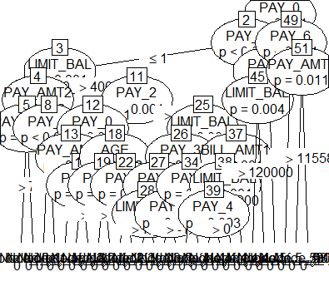
The decision classiferachived 40% accuracy

Slide 23
K – Means algorithm:-
K means clustering is one of the most popular unsupervised learning methods in machine learning. This algorithms helps identify”k” possible group(cluster) from “n” elements based on the distances between the elements.
A more detailed explanation would be: the algorithms finds out the distances among each elements in your data, then find the number of centroid,allocates the elements to the nearest centroids to form clusters,and the ultimates goal is to keep the size of each cluster as small as possible.
K-means can be used in multiple ways.For instances, Customer segmentation, insurance fraud detection, document classification,etc.
K means is a clustering algorithm, ie we have points in n- dimensional space, and we want to form them group having similar characteristics.
Workflow:-
Assign or arbitrarily choose k points as the initial cluster centers.
Reassign each object/points to the cluster to which the object/points are the most similar based on the mean values of the objects in the cluster.
Update the cluster means,that is, calculate the mean value of the objects for each cluster.
Repeat (B) and (c) until no change:

Slide 24
Find K
In this step,we would need to know two terms,”wss” and “elbow rule”, to help us find the best number of centroids.
WSS:-
The sum distance within the centroids.Since the K- means algorithm’s goal is to keep the size of each cluster as small as possible,the small wss indicates that every data point is close to its nearest centroids,or say the model has returned good results.
Elbow rule/method:
A heuristic used in determing the number of cluster in a dataset.We first plot our the WSS score against the number of K.Because with the number of K increasing,the WSS will always decrease; however,the magnitude of decrease between each k will be diminishing,and plot will be a curve which looks like an arm that curled up.In this way,we secondly need to find out which points falls on the elbow.

Slide 25
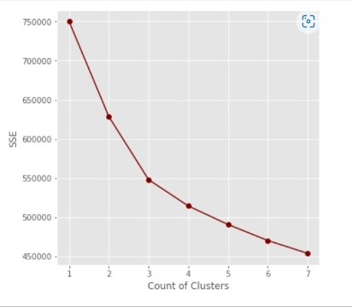
Elbow method
From the above plot, we look for an elbow where sum of square beings to bend.
This is typically optimal number of cluster for this plot each appeared that there is a bit of elbow or
bend at K=3 cluster
In our dataset,15916 be observation in cluster 2
10518 be observation in cluster 1
3566 be observation in cluster 3
TABLE:-
 | 1 | 2 | 3
0 | 8785 | 11687 | 2892
1 | 1733 | 4229 | 674

Slide 26
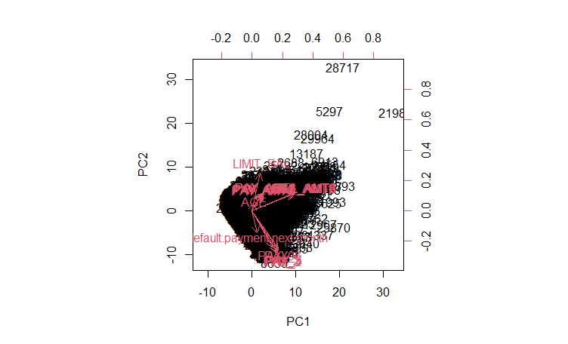
PCA – PRINCIPAL COMPONENT ANALYSIS
PCA is a statistical technique for reducing the dimension of an mxn dataset such a way that a set of values possibly correlated variables into a set of linearly uncorrelated variables namely principal components.
The first principal component direction of the data is the one along which the observation vary the most.Likewise the first principal components as the 2nd most vary and so on.

Slide 27
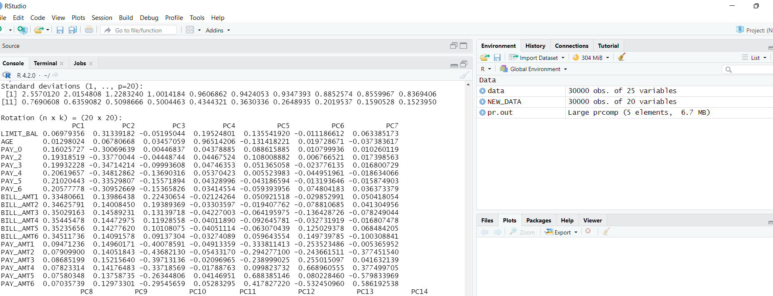
PRINCIPAL COMPONENT

Slide 28
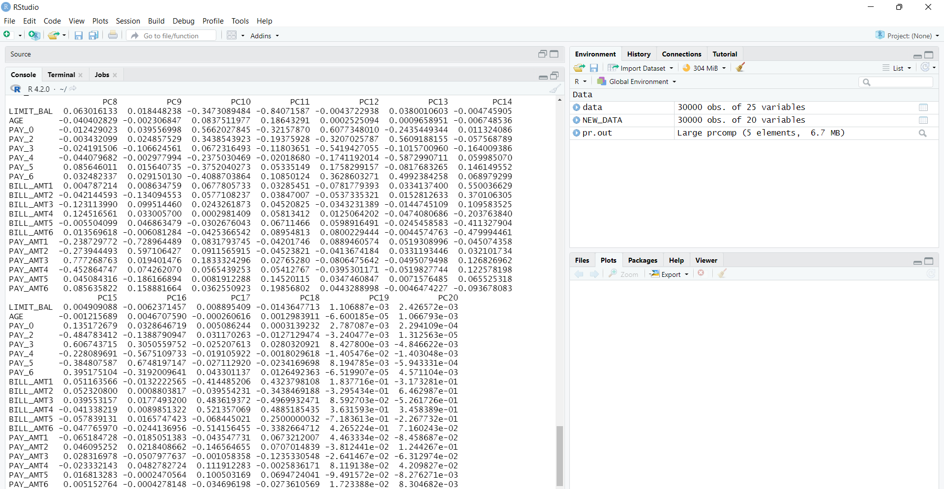

Slide 29
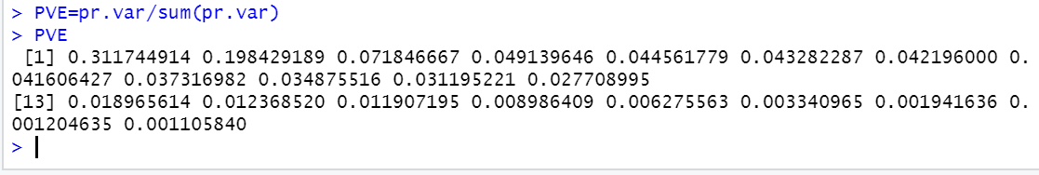
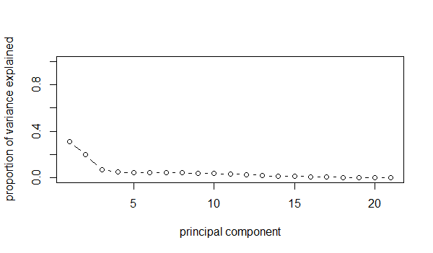
The proportion of variance explained by each principal component
SCREE PLOT OF PCA
Interpretation
Upto16th Principal components, it accounts for 98.61 variance for the whole
dataset. Where, we have 21 variables, the PCA is reduced to 16th linearly
uncorrelated variables which is an efficient dimension reduction.

Slide 30
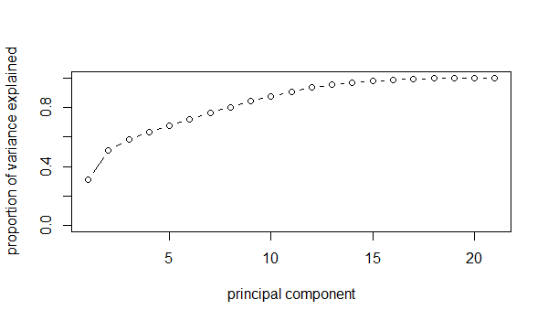
Cumulative scree plot

Slide 31
Conclusion:-
SL.NO | ALGORITHM | ACCURACY
1 | LOGISTIC | 80.75%
2 | KNN | 99.72%
3 | DECISION TREE | 40%
4 | KMEANS | ---------
5 | PCA | 98.67%
FUTURE WORK :- NEURAL NETWORK

Slide 32
THANK YOU

